Slide 1
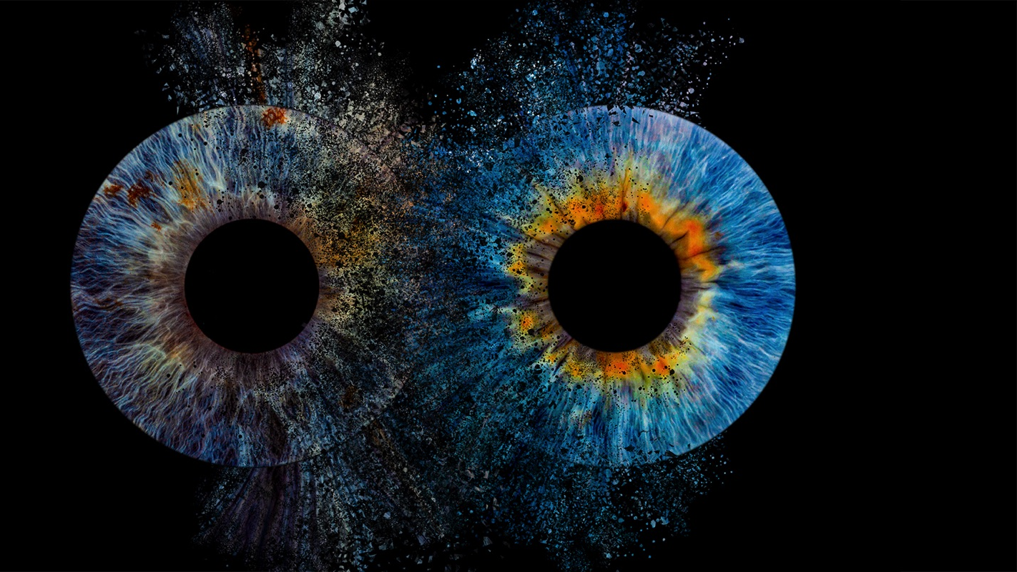
Corporate Social Responsibility of
"Iris Photo Art"
ТФ ФЕСТ 2025

Slide 2
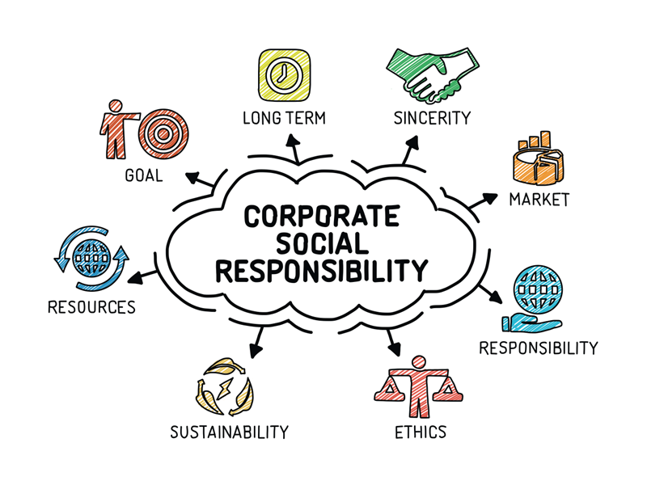
What is Corporate Social Responsibility (CSR)?
Definition: CSR is the commitment of companies to operate ethically and sustainably, contributing to the development of society and the environment.
Why is CSR important?
Improves the company's image
Increases customer trust
Supports social and environmental development

Slide 3
Mission and Vision of "Iris Photo Art"
Vision:
We strive for Iris Photo Art to become a leading brand in macrophotography, recognized for creativity, reliability, and innovation.
Mission:
We provide high-quality products and services in macrophotography, building long-lasting partnerships based on trust and value.

Slide 4
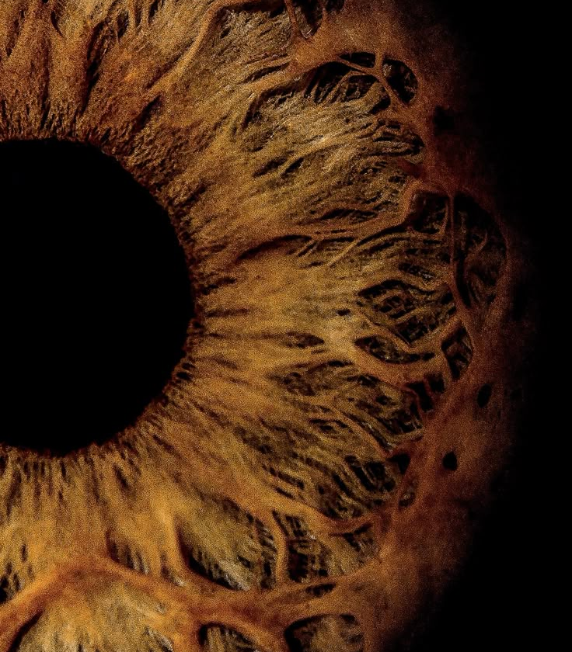
Main Directions of CSR at "Iris Photo Art"
Education and access to art
Environmental sustainability
Support for social causes
Cultural and community projects

Slide 5
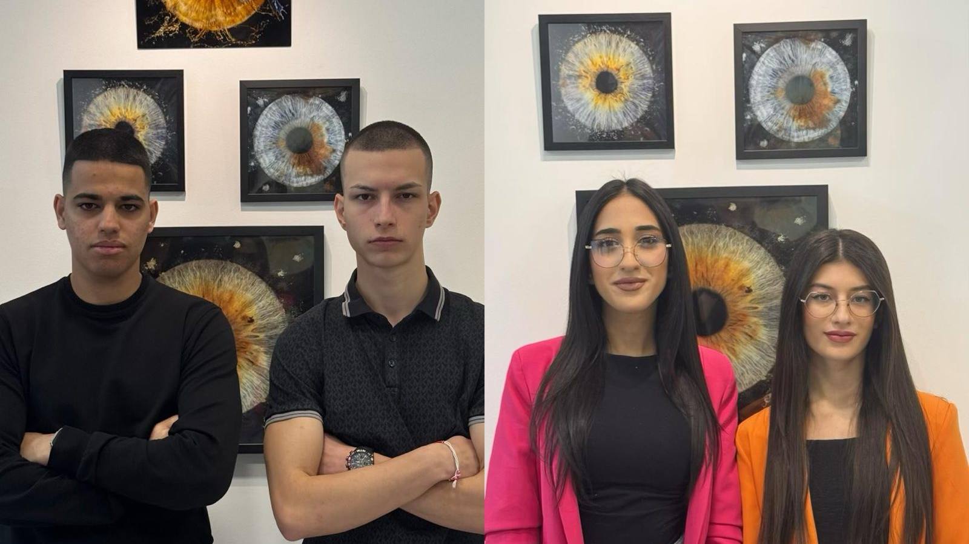
Education and access to art
• Organizing free photography courses for children and young people
• Collaboration with schools and universities
• Conducting workshops for socially disadvantaged groups

Slide 6
Environmental sustainability
• Minimizing waste and recycling
• Planting trees for every 100 photo products sold
• Using eco-friendly materials for printing

Slide 7
Support for social causes
• Donations of photography services to charitable organizations
• Free photo sessions for disadvantaged families
• Organizing charity photo exhibitions

Slide 8
Cultural and community projects
• Supporting young photographers through competitions and exhibitions
• Collaboration with galleries and art spaces
• Organizing events that promote art

Slide 9
Results and Impact
Education and Art:
• Free courses and workshops for children and young people
Social Support:
• Charity photo exhibitions and free photo sessions
Cultural Development:
• Support for young photographers and partnerships with galleries
RESULTS
IMPACT

Slide 10
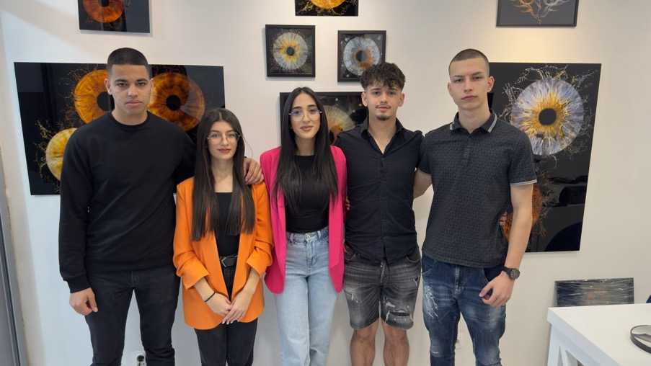
THANK YOU FOR THE ATTENTION!

